Slide 1
Contemporary Issues in Leadership
How leaders frame, inspire and influences followers

Slide 2
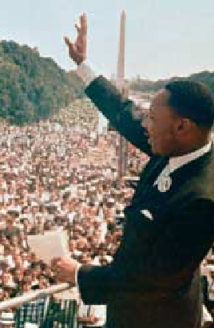
Framing: Using Words to Shape Meaning and Inspire Others
Framing
A way to use language to manage meaning.
Leaders use framing (selectively including or excluding facts) to influence how others see and interpret reality.

Slide 3
Inspirational Approaches to Leadership
Looking at leaders who inspire followers through their words, ideas and behaviour
Charismatic Leadership Theory
charisma: (Greek) gift
Robert House: first researcher to consider charismatic leadership in terms of OB
Followers make attributions of heroic or extraordinary leadership abilities when they observe certain behaviors.
A number of studies have tried to identify the characteristics of the charismatic leader

Slide 4
Key Characteristics of Charismatic Leaders
Vision and articulation. Has a vision—expressed as an idealized goal—that proposes a future better than the status quo; and is able to clarify the importance of the vision in terms that are understandable to others.
Personal risk. Willing to take on high personal risk, incur high costs and engage in self-sacrifice to achieve the vision.
Sensitivity to follower needs. Perceptive of others’ abilities and responsive to their needs and feelings.
Unconventional behavior. Engages in behaviors that are perceived as novel and counter to norms.

Slide 5
Are charismatic leaders born or made?
It is true that individuals are born with traits that make them charismatic...but is is possible to change
firstly
  develop an aura of charisma by maintaining an optimistic view
  be passionate as a catalyst to generate enthusiasm
  communicate with the whole body, not just words
secondly
  create a bond that inspires others to follow
thirdly
  bring out the potential in followers by tapping into their emotions

Slide 6
DOWN SIDE OF CHARISMATIC LEADERSHIP
Ego-centric and self centered individuals can use organisations for their own gains
Because of their power to captivate others, charismatic leaders can be dangerous as they can convince their followers towards a vision which leads to disaster

Slide 7
Transactional and Transformational Leadership
Transactional Leaders
Leaders who guide or motivate their followers in the direction of established goals by clarifying role and task requirements.
Transformational Leaders
Leaders who inspire individuals to go beyond self interest for organisational good and have extraordinary effect on their followers.

Slide 8
How Transformational Leadership works
Transformational leaders encourage followers to be more creative and innovative, take risks.
Followers of transformational leaders are more likely to pursue ambitious goals, be familiar with and agree to the organisation’s goals.
Vision plays an important role in transformational leadership
Commitment of followers and instils in them a greater sense of trust in the leader.

Slide 9
Authentic Leadership:
Those who ....
Know who they are
know what they believe in and value
Act on the values and beliefs openly and candidly

Slide 10
Authentic Leadership
Ethics and Trust
Why now…
Many past leaders suffered from ethical shortcomings (enron, arthur anderson, merril lynch, Satyam)‏
Unethical leaders are more likely to use their charisma to enhance their power over followers, directed to self-serving ends.
Abuse of power
Top executives set the moral tone of the organisation

Slide 11
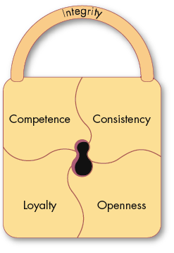
Trust: The Foundation of Leadership [role in shaping strong leaders]
Trust
A positive expectation that another will not—through words, actions, or decisions—act opportunistically.
Trust is a history-dependent process (familiarity) based on relevant but limited samples of experience (risk).

Slide 12

Dimensions of Trust
Integrity
  honesty and truthfulness.
Competence
  an individual’s technical and interpersonal knowledge and skills.
Consistency
  an individual’s reliability, predictability, and good judgment in handling situations.
Loyalty
  the willingness to protect and save face for another person.
Openness
  reliance on the person to give you the full truth.
If people are going to follow someone willingly, they need assurances that the person is worthy of their trust.

Slide 13

Three Types of Trust in
organisational relationships
Deterrence-based Trust
Trust based on fear of reprisal if the trust is violated.
Knowledge-based Trust
Trust based on behavioral predictability that comes from a history of interaction.
Identification-based Trust
Trust based on a mutual understanding of each other’s intentions and appreciation of the other’s wants and desires.

Slide 14
A DEMANDING JOB
Required leadership skills in the future
No.
Skill
in %
No.
Skill
in %
1
Collaboration (working across boundaries effectively)‏
49
11
Resourcefulness
17
2
Change leadership
38
12
Leveraging differences
16
3
Building effective teams
33
13
Global awareness
15
4
Influence without authority
33
14
Decisiveness
13
5
Driving innnovation
29
15
Doing whatever it takes (finding any way to get results)‏
13
6
Coaching
26
16
Straightforwardness & composure
10
7
Building and mending relationships
25
17
Credibility
9
8
Adaptability
25
18
Ethical decision making
8
9
Paying attention(seeing things from different angles)‏
24
19
Other
5
10
Co-inquiry (learning from others through questions)‏
17

Slide 15
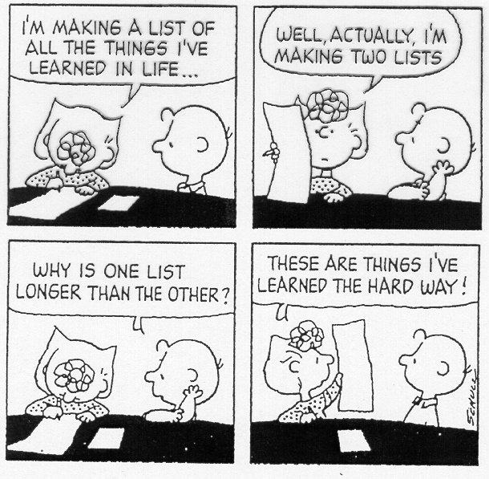
Contemporary Leadership Roles: Mentoring
Mentor
A senior employee who sponsors and supports a less-experienced employee (a protégé).
Successful mentors...
Present ideas clearly
Listen well
Empathize
Share experiences
Act as role model
Share contacts
Provide guidance

Slide 16
Mentoring relationships
Career functions
  Lobbying to get protégé challenging, visible assignments
  Coaching to develop skills
  Nominating protégé for advances /promotion
  Act as sounding board for ideas

Slide 17
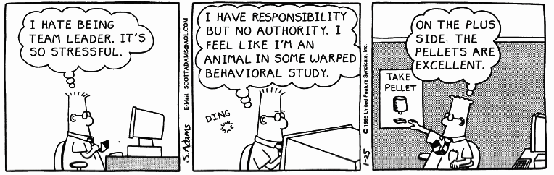
Source: DILBERT reprinted by permission of United Features Syndicate, Inc.

Slide 18
Contemporary Leadership Roles:
Self-Leadership
Self-Leadership
A set of processes through which individuals control their own behavior.
Effective leaders help followers to lead themselves.
Why? So that they wont need to depend on formal leaders for direction and motivation
Creating self leaders:
Model self-leadership.
Encourage employees to create self-set goals.
Encourage the use of self-rewards.
Create positive thought patterns.
Create a climate of self-leadership.
Encourage self-criticism.

Slide 19
Challenges to the Leadership Construct
Leaders cannot do everything. [looking for a target to vent your …]
Two perspectives that challenge widely held belief in the importance of leadership.
Attribution Theory of Leadership
The idea that leadership is merely an attribution that people make about other individuals.
Qualities attributed to leaders:
Leaders are intelligent, outgoing, have strong verbal skills, are aggressive, understanding, and industrious.
Effective leaders are perceived as consistent and unwavering in their decisions.
Effective leaders project the appearance of being a leader.

Slide 20
How can organisations find and create Effective Leaders
Selection
  Review specific requirements for the job.
  Use tests that identify personal traits associated with leadership, measure self-monitoring, and assess emotional intelligence.
  Conduct personal interviews to determine candidate’s fit with the job.
Training
  Recognize that all people are not equally trainable.
  Teach skills that are necessary for employees to become effective leaders.
  Provide behavioral training to increase the development potential of nascent charismatic employees.

